Slide 1
Consciousness, soul, language and Nation

Slide 2
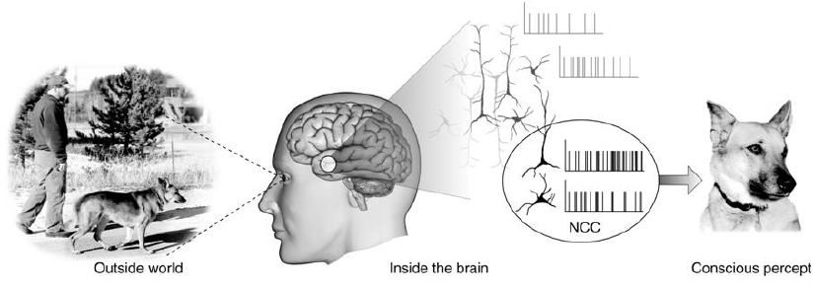
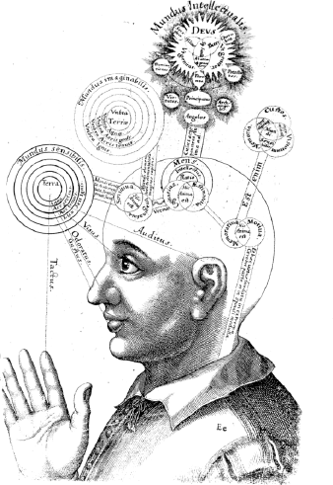
Consciousness
Representation of consciousness from the seventeenth century by Robert Fludd, an English Paracelsian physician

Slide 3
Consciousness at its simplest refers to sentience or awareness of internal or external existence. Despite centuries of analyses, definitions, explanations, and debates by philosophers and scientists, consciousness remains puzzling and controversial, being both the most familiar and the most mysterious aspect of our lives. Perhaps the only widely agreed notion about the topic is the intuition that it exists.
Beyond the problem of how to define consciousness, there are also issues of whether non-human creatures have consciousness, and if so in what form; is consciousness a biological function, is it purely material depending on the functions of the physical brain; can machines, or artificial intelligence, have consciousness; is there an evolutionary progression to consciousness such that human consciousness of a higher order; and is human consciousness a spiritual function, not just cognitive? The answers to these questions are the avenue to greater understanding of what it means to be human.

Slide 4
The origin of the modern concept of consciousness is often attributed to John Locke's Essay Concerning Human Understanding, published in 1690, where he discusses the role of consciousness in personal identity:
Consciousness which is inseparable from thinking, and, as it seems to me, essential to it: it being impossible for any one to perceive without perceiving that he does perceive. When we see, hear, smell, taste, feel, meditate, or will anything, we know that we do so. ... For, since consciousness always accompanies thinking, and it is that which makes every one to be what he calls self, and thereby distinguishes himself from all other thinking things, in this alone consists personal identity.
The English word "conscious" originally derived from the Latin conscius (con- "together" and scio "to know"). However, the Latin word did not have the same meaning as the English word—it meant "knowing with," in other words "having joint or common knowledge with another."

Slide 5
At its simplest, consciousness refers to "sentience or awareness of internal or external existence." It has been defined variously in terms of "qualia," subjectivity, the ability to experience or to feel, wakefulness, having a sense of selfhood or soul, the fact that there is something 'that it is like' to 'have' or 'be' it, and the executive control system of the mind. Despite the difficulty in definition, many philosophers believe that there is a broadly shared underlying intuition about what consciousness is. In sum, "Anything that we are aware of at a given moment forms part of our consciousness, making conscious experience at once the most familiar and most mysterious aspect of our lives.«
In the Cambridge Dictionary we find consciousness defined as:
"the state of understanding and realizing something."
The Oxford Dictionary offers these definitions:
"A person's awareness or perception of something" and
"The fact of awareness by the mind of itself and the world.«
Philosophers have used the term 'consciousness' for four main topics: knowledge in general, intentionality, introspection (and the knowledge it specifically generates) and phenomenal experience.

Slide 6
Mental processes (such as consciousness) and physical processes (such as brain events) seem to be correlated. However, the specific nature of the connection is unknown. The philosophy of mind has given rise to many stances regarding consciousness. In particular, the two major schools of thought regarding the nature of the mind and the body, Dualism and monism, are directly related to the nature of consciousness.
Dualism, originally proposed by René Descartes, is the position that mind and body are separate from each other.[17] Dualist theories maintain Descartes' rigid distinction between the realm of thought, where consciousness resides, and the realm of matter, but give different answers for how the two realms relate to each other. The two main types of dualism are substance dualism, which holds that the mind is formed of a distinct type of substance not governed by the laws of physics, and property dualism, which holds that the laws of physics are universally valid but cannot be used to explain the mind.
Monism, on the other hand, rejects the dualist separation and maintains that mind and body are, at the most fundamental level, the same realm of being of which consciousness and matter are both aspects. This can mean that both are mental, such that only thought or experience truly exists and matter is merely an illusion (idealism); or that everything is material (physicalism), which holds that the mind consists of matter organized in a particular way; and neutral monism, which holds that both mind and matter are aspects of a distinct essence that is itself identical to neither of them.

Slide 7
Soul Rational Soul (Thinking) Wisdom Spirited Soul (Willing) Courage Appetitive Soul (Feeling) Moderation
Soul is the active principle present in living things.
Plato distinguished three distinct components of the human soul.
Plato held that every human being includes three souls (Gk. ψυχη [psychê]) that correspond to the three classes of citizen within the state, each of them contributing in its own way to the successful operation of the whole person.
The rational soul (mind or intellect) is the thinking portion within each of us, which discerns what is real and not merely apparent, judges what is true and what is false, and wisely makes the rational decisions in accordance with which human life is most properly lived.
The spirited soul (will or volition), on the other hand, is the active portion; its function is to carry out the dictates of reason in practical life, courageously doing whatever the intellect has determined to be best.
Finally, the appetitive soul (emotion or desire) is the portion of each of us that wants and feels many things, most of which must be deferred in the face of rational pursuits if we are to achieve a salutary degree of self-control.

Slide 8
According to Aristotle, every animate being is a living thing which can move itself only because it has a soul. Animals and plants, along with human beings, are more like each other than any of them are like any inanimate object, since each of them has a soul. Thus, his great treatise on psychology, On The Soul, offers interconnected explanations for the functions and operations of all living organisms.
All such beings, on Aristotle's view, have a nutritive soul which initiates and guides their most basic functions, the absorption of food, growth, and reproduction of its kind. All animals (and perhaps some plants) also have a sensitive soul by means of which they perceive features of their surroundings and move in response to the stimuli this provides. Human beings also possess (in addition to the rest) a rational soul that permits representation and thought. (On the Soul II 2)
Notice that each living thing has just one soul, the actions of which exhibit some degree of nutritive, sensitive, and/or rational functioning. This soul is the formal, efficient, and final cause of the existence of the organism; only its material cause resides purely in the body. Thus, all of the operations of the organism are to be explained in terms of the functions of its soul.

Slide 9
I Am a Thinking Thing
An initial consequence may be drawn directly from the intuitive certainty of the cogito itself. If I know that I am, Descartes argued, I must also know what I am; an understanding of my true nature must be contained implicitly in the content of my awareness.
What then, is this "I" that doubts, that may be deceived, that thinks? Since I became certain of my existence while entertaining serious doubts about sensory information and the existence of a material world, none of the apparent features of my human body can have been crucial for my understanding of myself. But all that is left is my thought itself, so Descartes concluded that "sum res cogitans" ("I am a thing that thinks"). (Med. II) In Descartes's terms, I am a substance whose inseparable attribute (or entire essence) is thought, with all its modes: doubting, willing, conceiving, believing, etc. What I really am is a mind [Lat. mens] or soul [Lat. anima]. So completely am I identified with my conscious awareness, Descartes claimed, that if I were to stop thinking altogether, it would follow that I no longer existed at all. At this point, nothing else about human nature can be determined with such perfect certainty.
In ordinary life, my experience of bodies may appear to be more vivid than self-consciousness, but Descartes argued that sensory appearances actually provide no reliable knowledge of the external world. If I hold a piece of beeswax while approaching the fire, all of the qualities it presents to my senses change dramatically while the wax itself remains. (Med. II) It follows that the impressions of sense are unreliable guides even to the nature of bodies. (Notice here that the identity of the piece of wax depends solely upon its spatial location; that's a significant hint about Descartes's view of the true nature of material things, which we'll see in more detail in Meditation Five.)

Slide 10

Language
Language is a structured system of communication that consists of grammar and vocabulary. It is the primary means by which humans convey meaning, both in spoken and written forms, and may also be conveyed through sign languages. The vast majority of human languages have developed writing systems that allow for the recording and preservation of the sounds or signs of language.
Human languages possess the properties of productivity and displacement, which enable the creation of an infinite number of sentences, and the ability to refer to objects, events, and ideas that are not immediately present in the discourse. The use of human language relies on social convention and is acquired through learning.
A mural in Teotihuacan, Mexico (c. 2nd century) depicting a person emitting a speech scroll from his mouth, symbolizing speech

Slide 11
Depending on philosophical perspectives on the definition of language and meaning, when used as a general concept, "language" may refer to the cognitive ability to learn and use systems of complex communication, or to describe the set of rules that makes up these systems, or the set of utterances that can be produced from those rules. All languages rely on the process of semiosis to relate signs to particular meanings. Oral, manual and tactile languages contain a phonological system that governs how symbols are used to form sequences known as words or morphemes, and a syntactic system that governs how words and morphemes are combined to form phrases and utterances.
The scientific study of language is called linguistics. Critical examinations of languages, such as philosophy of language, the relationships between language and thought, how words represent experience, etc., have been debated at least since Gorgias and Plato in ancient Greek civilization. Thinkers such as Jean-Jacques Rousseau (1712–1778) have argued that language originated from emotions, while others like Immanuel Kant (1724–1804) have argued that languages originated from rational and logical thought. Twentieth century philosophers such as Ludwig Wittgenstein (1889–1951) argued that philosophy is really the study of language itself.
Greek philosophers such as Gorgias and Plato debated the relation between words, concepts and reality. Gorgias argued that language could represent neither the objective experience nor human experience, and that communication and truth were therefore impossible. Plato maintained that communication is possible because language represents ideas and concepts that exist independently of, and prior to, language.

Slide 12
One definition sees language primarily as the mental faculty that allows humans to undertake linguistic behavior: to learn languages and to produce and understand utterances. This definition stresses the universality of language to all humans, and it emphasizes the biological basis for the human capacity for language as a unique development of the human brain.
Another definition sees language as a formal system of signs governed by grammatical rules of combination to communicate meaning. This definition stresses that human languages can be described as closed structural systems consisting of rules that relate particular signs to particular meanings. This structuralist view of language was first introduced by Ferdinand de Saussure, and his structuralism remains foundational for many approaches to language.
Another definition sees language as a system of communication that enables humans to exchange verbal or symbolic utterances. This definition stresses the social functions of language and the fact that humans use it to express themselves and to manipulate objects in their environment. Functional theories of grammar explain grammatical structures by their communicative functions. This view of language is associated with the study of language in pragmatic, cognitive, and interactive frameworks, as well as in sociolinguistics and linguistic anthropology.
In the philosophy of language, the view of pragmatics as central to language and meaning is often associated with Wittgenstein's later works and with ordinary language philosophers such as J.L. Austin, Paul Grice, John Searle, and W.O. Quine.

Slide 13
Nation
Nationalism is the doctrine that one's national culture and interests are superior to any other, and that nations should act independently (rather than collectively) to attain their goals. It holds that a nation, usually defined in terms of language, ethnicity or culture, has the right to constitute an independent or autonomous political community based on a shared history and common destiny. It can also refer to the aspiration for national independence felt by people under foreign domination.
Nationalism seeks to order the world as a series of nation-states, each based on the geopolitical national homeland of its respective nation, and holds that each nation has a moral entitlement to a sovereign state. It seeks to guarantee the continued existence of a nation, to preserve its distinct identity, and to provide a territory where the national culture and ethos are dominant. In turn, nation-states appeal to a national cultural-historical mythos to justify their existence, and to confer political legitimacy.

Slide 14
Nationalism may manifest itself along civic, ethnic, cultural, religious or ideological lines.
Ethnic Nationalism: where the nation is defined in terms of ethnicity and descent from previous generations. It also includes the idea of a culture shared between members of the group, and usually a shared language.
Civic Nationalism: where the state derives political legitimacy from the active participation of its citizenry and from the degree to which it represents the "will of the people".
State Nationalism: a variant of Civic Nationalism, where the nation is assumed to be a community of those who contribute to the maintenance and strength of the state, and that the individual exists in the community expressly to contribute to this goal.
Expansionist Nationalism: a radical form of imperialism (and not really true Nationalism at all) that incorporates autonomous, patriotic sentiments with a belief in expansionism, usually by military aggression.
Liberal Nationalism: where it is claimed that individuals need a national identity in order to lead meaningful, autonomous lives, and that liberal democracies need national identity in order to function properly. John Stuart Mill expressed similar sentiments.
Religious Nationalism: where a shared religion can be seen to contribute to a sense of national unity, and a common bond among the citizens of the nation.

